Slide 1



Slide 2
Agenda
12:30 - Introduction
12:45 - Company News
13:00 - Spira 5.4 Updates
13:30 – Break
13:45 – PTA Presentation
14:00 - Spira 6 Roadmap
14:45 – Break
15:00 - Rapise Showcase
15:30 - KronoDesk 3.0
15:45 - Q&A

Slide 3
Company News

Slide 4
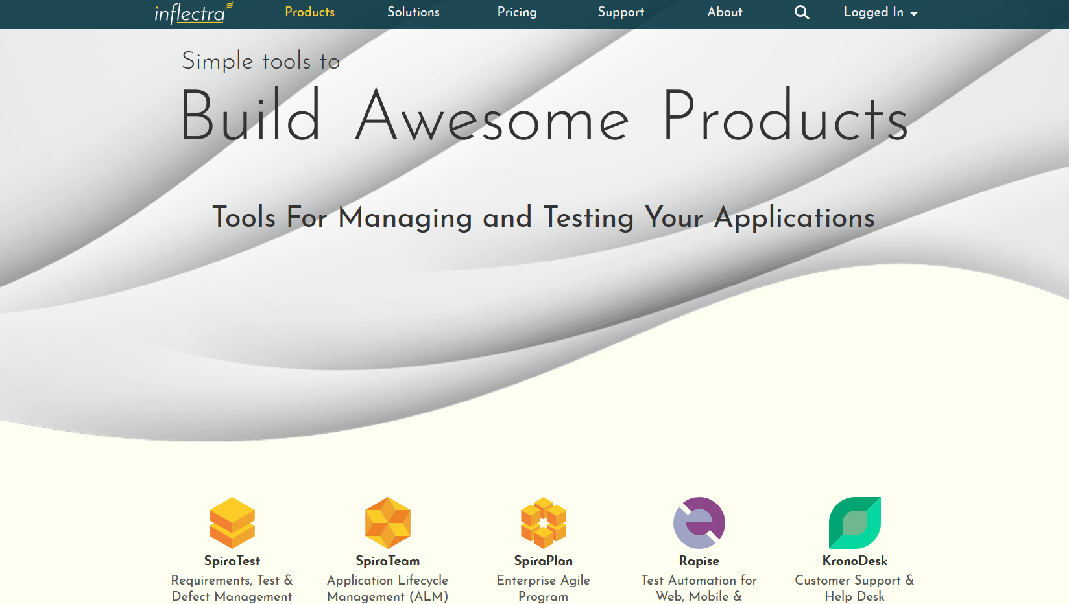
Company Updates – New Website

Slide 5
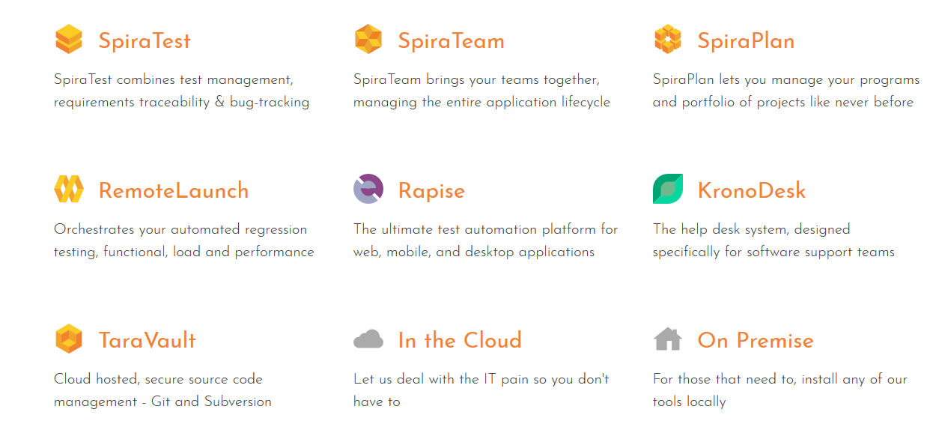
Company Updates – New Product Logos

Slide 6
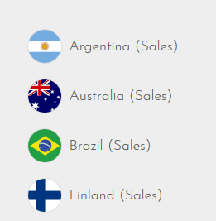
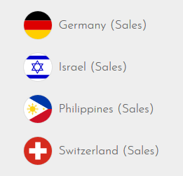
Company Updates - Countries
Sales Offices Opened in the following countries:

Slide 7



Spira EU Cloud Hosting Options
DATIS
  Hosted in Mannheim, Germany
  Enterprise Grade Data Center
  100% Green Energy
Amazon Web Services (AWS)
  Hosted in Ireland
  Amazon EC2
  Amazon EBS Encrypted Volumes

Slide 8
The Inflectra® Product Suite
KronoDesk®
IT Support & Help Desk Ticketing
SpiraPlan®
Agile Program & Portfolio Management
SpiraTeam®
Application Lifecycle Management (ALM)
SpiraTest®
Requirements, Test Management
& Bug Tracking
TaraVault® - Source Code Management
Rapise®
Test Automation (Web, GUI, Services)

Slide 9
2018 Product Releases
SpiraTest, SpiraPlan & SpiraTeam
  5.3 – Exploratory and data-driven testing
  5.4 – Program management, Scrum, Kanban task/incident boards
Rapise
  5.5 – Codeless Data Driven Testing & Salesforce classic support
  5.6 – Support for Dynamics Business Central & Salesforce Lightning
  5.7 – Integrated Spreadsheet Editor for Test Data Management
KronoDesk
  2.1 – Support for user organizations and UI enhancements

Slide 10



2018 Conferences
North America
  STPcon – Newport Beach, CA
  Agile Government – Washington, DC
  Agile Testing Days USA, Boston, MA
  STAR Canada, Toronto, ON
  STPcon – Washington, DC
Europe
  QA Geek Week – Tel Aviv, Israel
  Agile Testing Days, Potsdam, Germany
Australia Testing Days
  Sydney & Melbourne

Slide 11
2019 Conferences (Current Plans)
North America
  STPcon – San Francisco, CA
  Agile in Government – Washington, DC
  Agile Testing Days USA, Chicago, IL
  STAR Canada, Toronto, ON
Europe
  EuroSTAR – Prague, Czechia
  Agile Testing Days, Potsdam, Germany
Australia Testing Days
  Sydney & Melbourne

Slide 12

Meetup Sponsorships
Inflectra is happy to sponsor and support local meetup groups, focused on agile, QA, BA topics:
  Sponsoring the Knoxville QA meetup
  Sponsoring the Bluegrass IIBA association
  Sponsoring the New York Test Masters meetups
Let us know you have a group that we can support?

Slide 13
Spira 5.x Updates

Slide 14
Highlights from Spira 5.0 – 5.4
User Interface Changes
Updated Graphing
Exploratory Testing
Test Configurations
Program Management
Scrum Task Boards
Kanban Incident Boards

Slide 15
The “New” SpiraPlan

Slide 16
SpiraPlan – The Enterprise Lifecycle Solution
SpiraPlan is the complete solution to manage your projects and programs:
SpiraPlan®
Agile Program & Portfolio Management
SpiraTeam®
Application Lifecycle Management (ALM)
SpiraTest®
Requirements, Test Management
& Bug Tracking
TaraVault® - Source Code Management

Slide 17
SpiraPlan – Enterprise Agile Planning
Enterprise Resource Management
Program & Portfolio Management
Project Management
Brainstorming & Idea Discovery
Software Development
IT Operations
Requirements Management
Software Testing & Quality Assurance
Support & Maintenance
Collaboration and Communication

Slide 18
PTA Presentation

Slide 19

Our Partnership with PTA & DATIS
2010 - Started with a call - Dennis Haßlöcher and Adam
2011 – Partnership between PTA and Inflectra Signed
2016 – DATIS Hosting for EU Customers
2017 – Inflectra User Summit in Mannheim
2018 - Inflectra.de created, supported by DATIS
+
+

Slide 20



Spira 6 Roadmap

Slide 21
SpiraPlan 6.0
Templates, Risk Management, Document Workflows

Slide 22
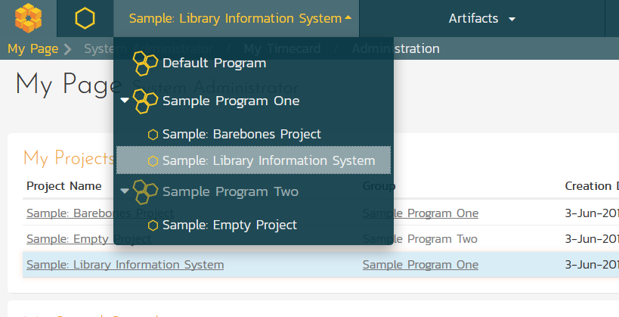
Updated Navigation & UI

Slide 23
Updated Navigation & UI

Slide 24
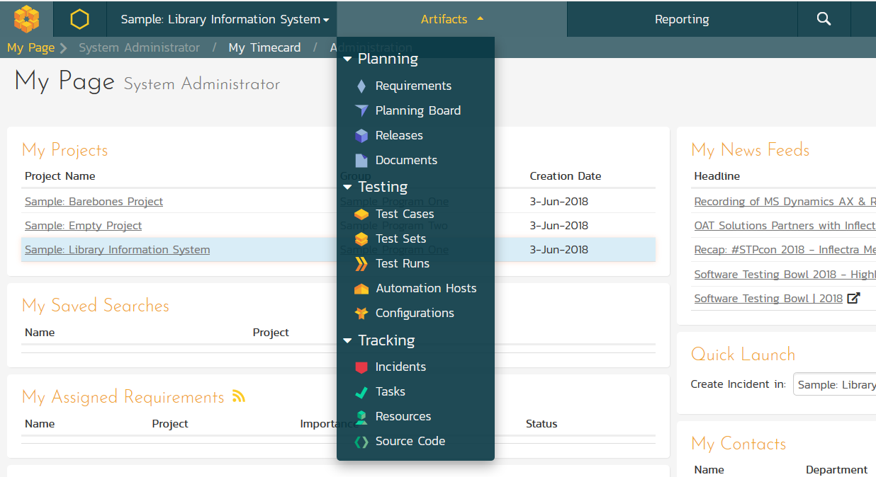
Updated Navigation & UI

Slide 25
Project Templates
Edit the types and priorities for requirements, test cases, tasks, and releases (like with incidents)
Have multiple projects created from / share the same template
Use that shared template to manage, in one place, the types and priorities of artifacts (including incidents)
Use that shared template to manage the workflows across all its projects, from one central place
Keep process abstracted from the project data

Slide 26
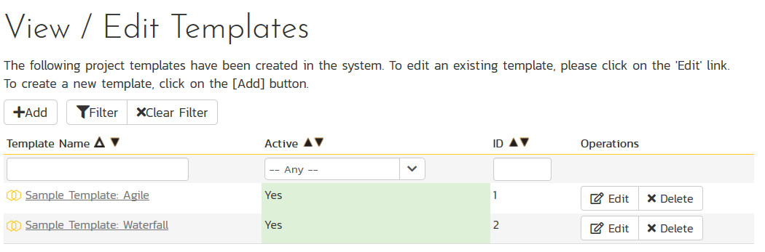
Project Templates

Slide 27
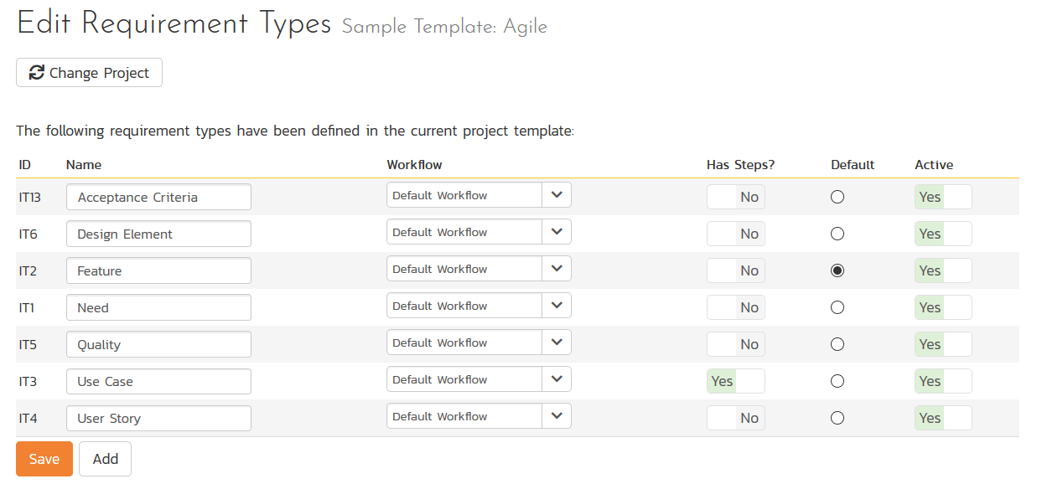
Project Templates

Slide 28
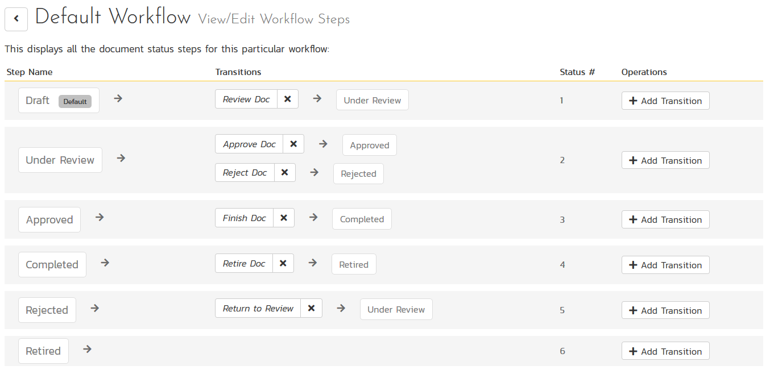
Document Workflows

Slide 29
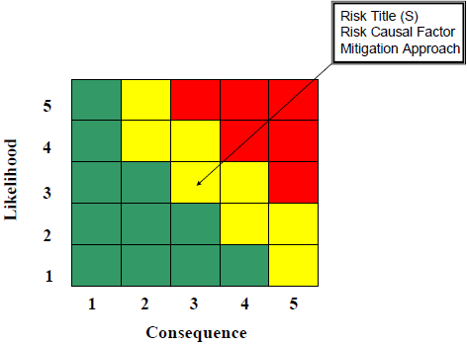
Enterprise Risk Management
Project Level Risk Management
  Track Risk Severity & Probability
Program Level Risk Management
  Assign overall risk status to projects and programs
Associations
  Ability to link Risks to other artifacts, with ‘mitigation’ sub-artifact available

Slide 30
SpiraPlan 6.1
Program Planning, GANTT Views, Roadmapping, Project & Program Portfolio Management

Slide 31
Portfolio & Program Management
Enterprise
Program
Project
Project
Project
Portfolio
Program
Project
Project
Program
Project
Project
Project
Portfolio
Program
Project
Project
Project
Program
Project
Project

Slide 32
Projects, Programs as Artifacts
Custom Properties available on:
  Users
  Projects
  Programs
  Portfolios
Track skills, technologies, other attributes
Project “Charter” to store project goals & objectives

Slide 33
Dates & Progress Across the Portfolio
Enterprise
Program
Project
Project
Project
Portfolio
Program
Project
Project
Program
Project
Project
Project
Portfolio
Program
Project
Project
Project
Program
Project
Project

Slide 34
Program Planning Roadmaps & Milestones
Program A:
Theme
Theme
Theme
Theme
Theme
Milestone A
Milestone B
Projects:
Req
Req
Req
Req
Req
Req
Req
Req
Req
Req

Slide 35
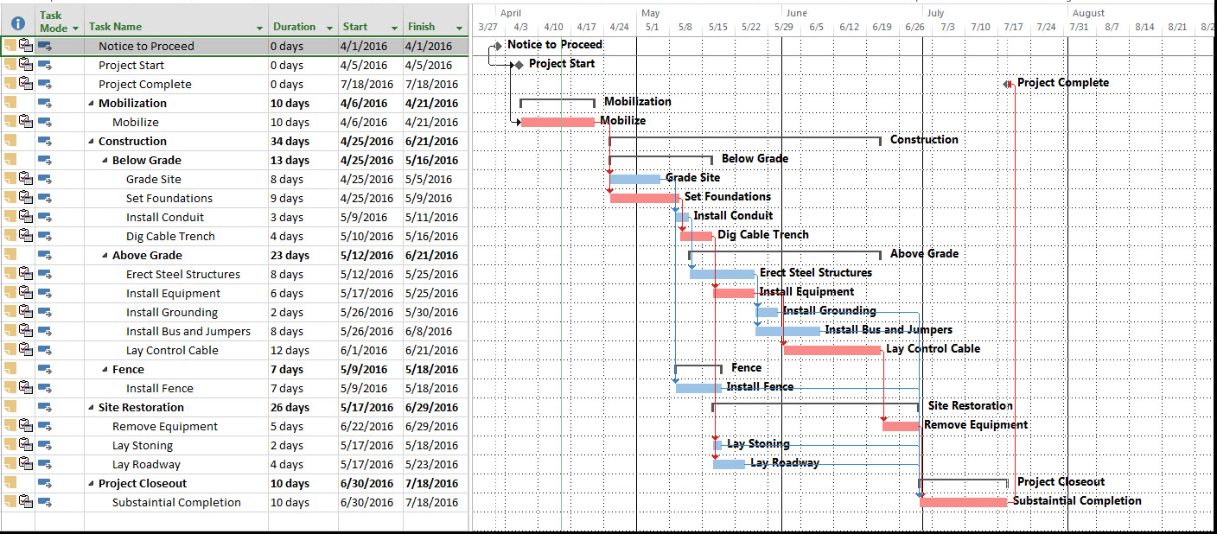
GANTT Chart View

Slide 36
SpiraPlan 6.2
Baselining, Tracks & Teams, Ideas, Risk-Based Testing

Slide 37
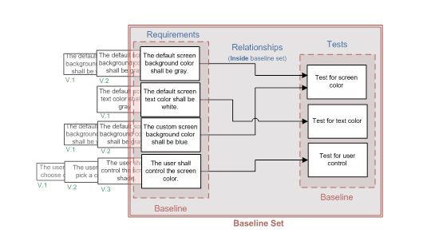
Baselining = Snapshots

Slide 38
Baselining to a Release
Take a snapshot of requirements (and test cases) that tied them to a particular release.
Creating the baseline requires specific permissions
Can switch between baselines by changing release
(future) can visually compare the differences between two baselines
Test Runs Automatically Associated with Baseline

Slide 39
Changes to History Tracking
Ability to Version Relationship Changes
  E.g. Requirement RQ1 linked to test cases TC1, TC2
  Requirement RQ2 updated and also linked to TC3
Ability to Version Positional Changes
  Test Step 4 moved to a new position
  Use Case Step 2 moved to a new position

Slide 40
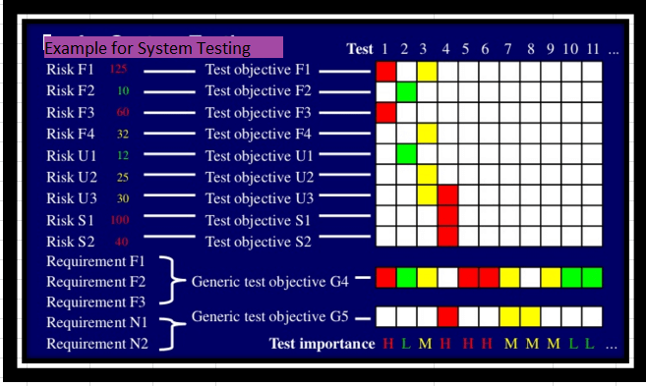
Risk-Based Testing
System will monitor metrics
around requirements
  Complexity, priority,
  task scope
System will review prior
testing activities
  Unstable tests, priority, # defects
System will suggest test plans automatically

Slide 41
Teams and Tracks
Group people by different classifications: eg teams or tracks or guilds, or any other nomenclature.
Tasks, bugs, tests could be assigned to a resource group, rather than individual
Groups could be used for notifications, following artifacts

Slide 42
Tracks
Major Release 1
Minor Release 1.1
Sprint 1
Sprint 2
Sprint 3
Req
Req
Req
Track A
Req
Req
Req
Req
Track B
Req
Req
Track C
Req

Slide 43
SpiraPlan 6.3
Resource Management, Time Tracking, Chat Enhancements

Slide 44
Schedule & Resource Planning
Plan notional releases (allocating roles by %age and time periods)
Allocations could have bill rates, base story points or hours attached
Different view options (calendar, Gantt)
Effort driven or schedule driven planning, with intelligent notifications from system (e.g. delays, need for more staff)
Can work on notional releases without affecting live release
Assess plans against reality (available resources, scheduling)

Slide 45
Schedule & Resource Planning
Planned Allocation
Actual Allocation

Slide 46
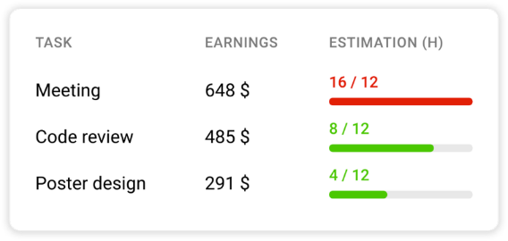
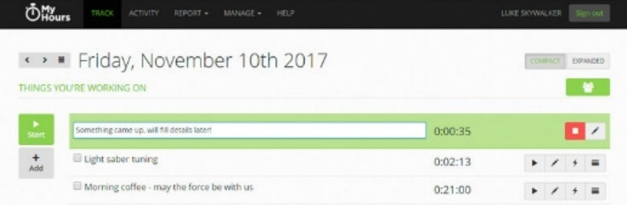
Timecards and Time Tracking
Capture the date of activity, not just the activity
Redesign the timecard (calendar view and entry, more summary data)
Reporting views of timecard data (across teams, projects, sprints)
Could log time live, and enter on artifacts pages too
How to add general time spent against a release?
Tracks against hours available – ie who works what hours on what days in what time zones (links to planning)

Slide 47
SpiraPlan 6.4
Code Review, Branching, Pull Requests, Financials, Earned Value Management

Slide 48
Capturing Unstructured Information
A new interface for capturing, storing, viewing things like: blue sky ideas, team info, new product concepts, pre release checklists
Completely unstructured? can add simple metadata (title, owner, tags)
Also allow structure? ordering and grouping (to create storyboards)
Used to create artifacts? Eg turn an indented list into requirements or releases

Slide 49
Financial Estimates and EVM Management
Use budgets, as well as resources to plan, track, manage projects
Can link time by person to an hourly rate to feed into billing
Should billing and tracking be 100% within SpiraPlan or are there clear enough market leaders we can concentrate on integrating with?
How important is it for SpiraPlan to meet the EVM guidelines?

Slide 50
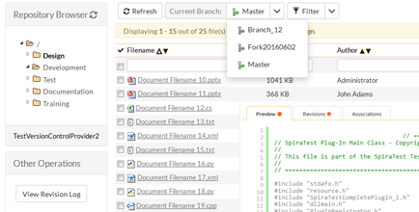
Improved Source Code Tools
Currently, source code is read only
Add line level interactions and
workflow processes to source code
Processes: code reviews and approval, potentially pull requests or branch merging
Line level interactions: comments, responses and questions, as part of a process as above
More powerful file view tools, including comparing two versions of a file live in the browser

Slide 51
Application Demo

Slide 52

Rapise Showcase

Slide 53



















Rapise 5.7 Supports
Web Applications
Mobile Applications
Cross-Platform Technologies
Windows Applications
Desktop Applications
Web Applications
Unit Test Frameworks
Integrations

Slide 54
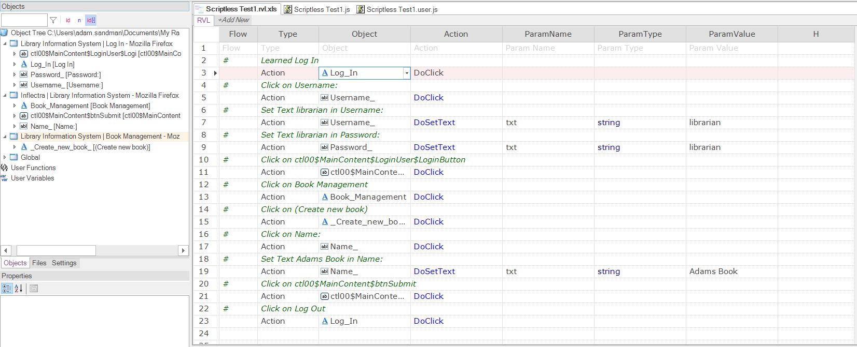
Rapise Visual Language (RVL)
Easier to use by analysts vs. programmers
Easier to maintain.

Slide 55
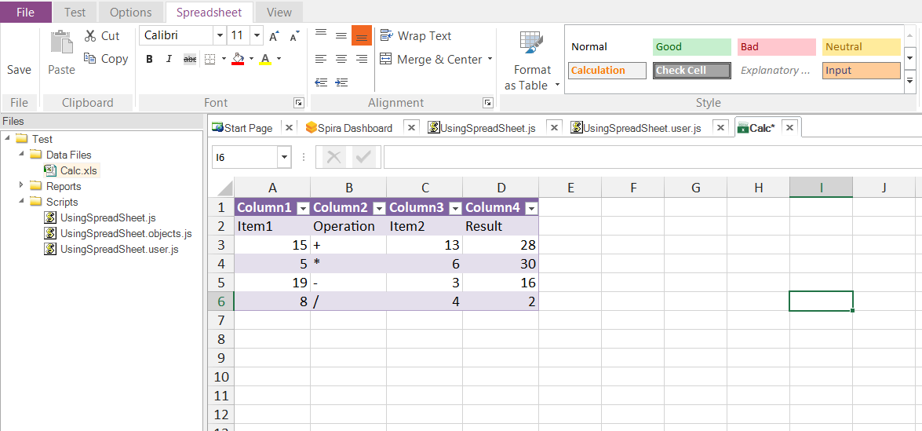
Data-Driven Testing – New Editor

Slide 56
Robotic Process Automation (RPA)
Fast & Cheap Implementation
Easy to Support
Local & Remote Scheduled & On Demand Execution
Data Access Control at UI Level
Uses Existing IT Systems

Slide 57
RPA Scenarios & Tasks
Fill a form based on data in external file
Create a record from incoming email
Import data from a spreadsheet or third-party system
Web scraping
Screen scraping
Terminal automation

Slide 58
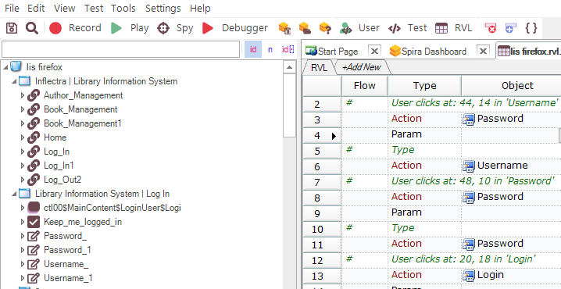
Rapise 6 – Bye Bye Ribbon!

Slide 59
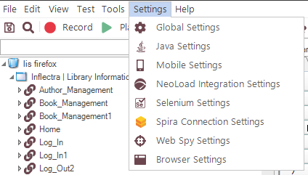
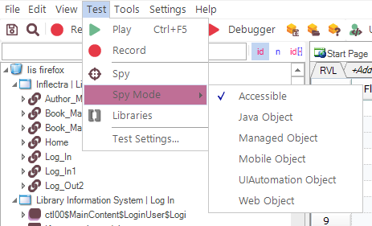
Rapise 6 - Hello… Menus

Slide 60
Application Demo

Slide 61

KronoDesk 3.0

Slide 62
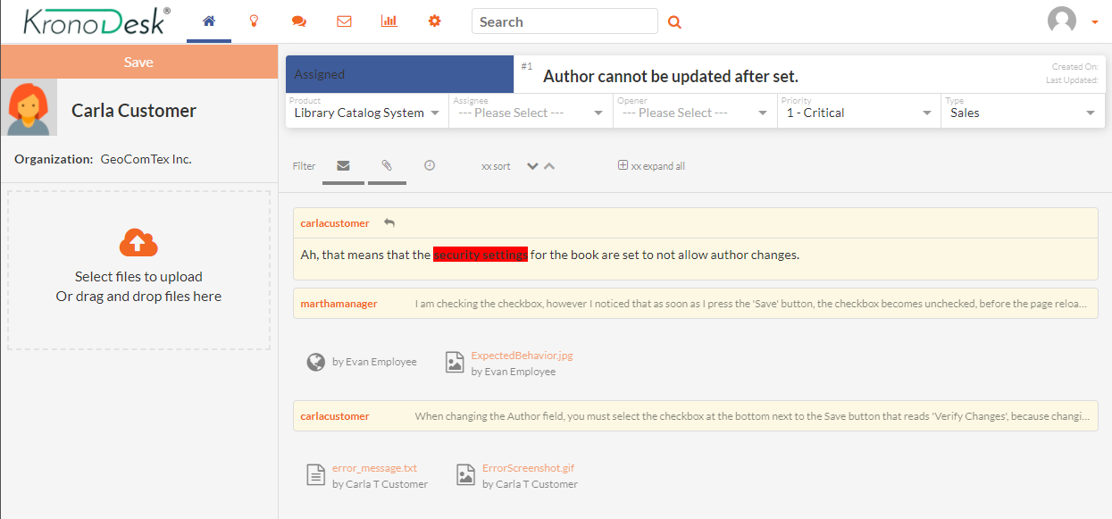
KronoDesk 3.0
Support Groups, SLAs, Escalations & UI Changes:

Slide 63
Questions ?

